Slide 1

Mental Health Disorder Diagnosis
Abraca-data
Ahnaf ryan, ankur Phadke, Shriram holla

Slide 2
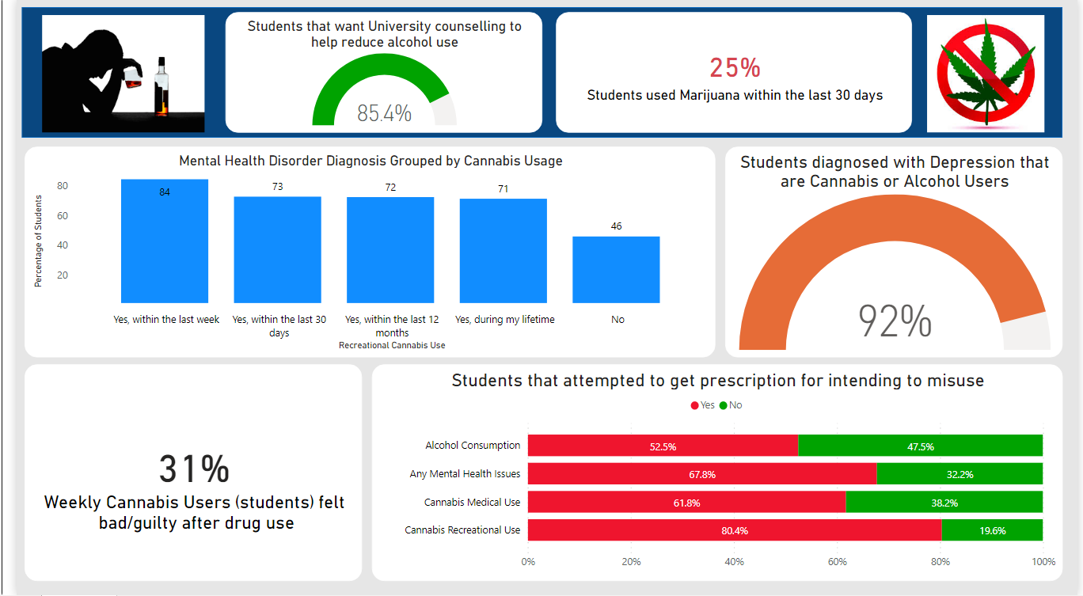

Slide 3
